Slide 1


Principal Asset Management
Project Lab – The University of Chicago
Equity Factor Construction and Analysis
Leah Li
Matheus Raka Pradnyatama
Nicolas Donato
Project Lab

Slide 2
Deliverables
Factor Construction
Back-Testing Pipeline
Formula Parser in R
Point-in-Time Data Collector in Excel
Sensitivity Analysis on Factor Measures
Project Lab

Slide 3
Factor Construction
Project Lab

Slide 4
Factor Construction
Using the paper titled “Global Factor Data Documentation” written by Theis Ingerslev Jensen, Bryan Kelly, Lasse Heje Pedersen
The constructed factors are mapped into relevant Bloomberg fields
This include:
Accounting variables: Gross Profit, Operating Income, Long-Term Debt, etc.
Market variables: Price, Return, Cash Dividend, Trading Volume, etc.
Lag variables were also constructed manually for Momentum Factor, modeled with prices across monthly durations
The constructed formula mappings are compiled into an excel file titled: “Formulas”
A previous version: “Formula Mappings - Paper to Bloomberg FLDS” was sent to Rajat Kathuria on April 16, 2025
Project Lab

Slide 5
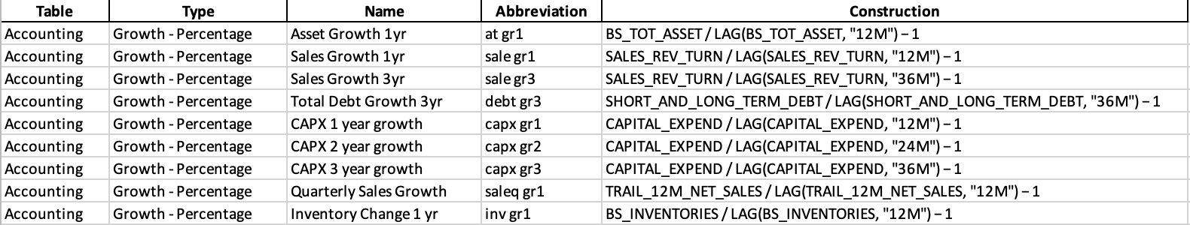
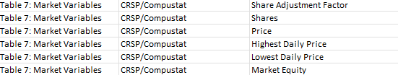
Factor Construction
Source: Formulas.xlsx
Table/Type - These columns determine the category of the factor. The factor can be from the accounting or market table, and there are various types within each.
Name/Abbreviation - These columns are the same factor names referenced in the Global Factor Data paper Documentation, Tables 5 - 8.
Construction - This column contains the formula to construct the factor using Bloomberg field names. This is what’s processed in the R parser script to calculate the factors.
Project Lab

Slide 6
Back-Testing Pipeline
Formula Parser in R
Project Lab

Slide 7
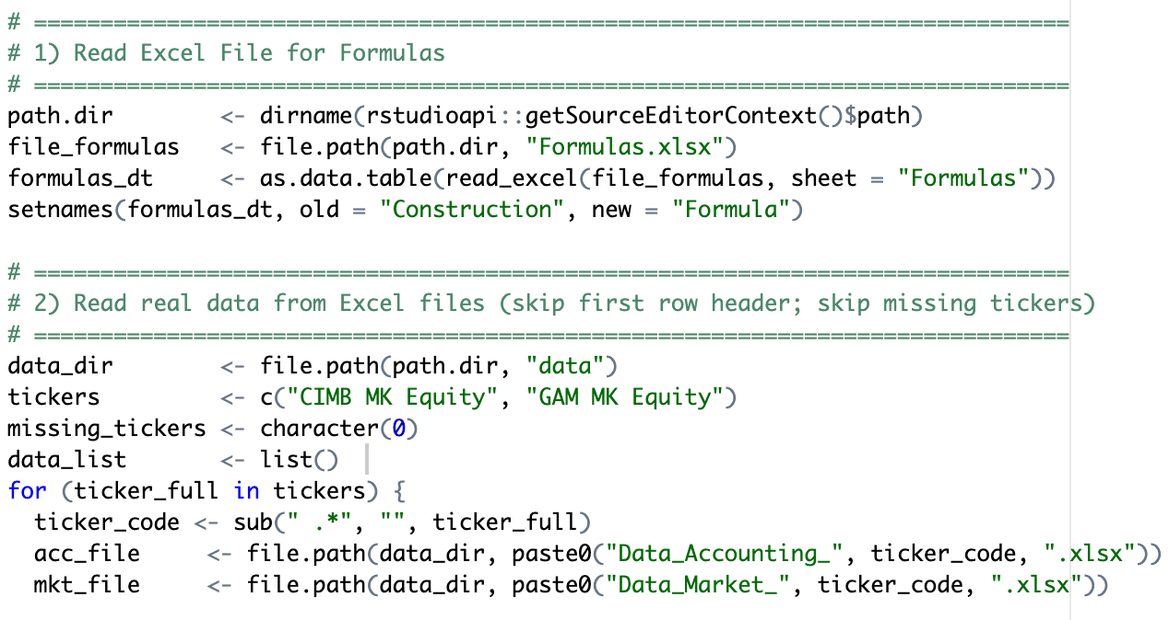
Formula Parser R - Load Data
Workflow Description
Load Formula Definitions
Read constructed formulas from Formulas.xlsx and recognizes variables
Ingest & Clean Raw Data
Iterate over each ticker, reading its “Accounting” and “Market” sheets
Standardize dates, strip non-numeric characters, lag accounting metrics by 4 months
Merge all tickers’ data into one long format ready for analysis
Source: formula_parser.r
Project Lab

Slide 8
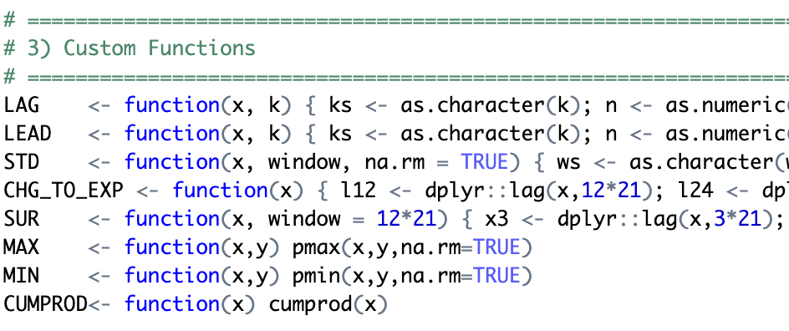
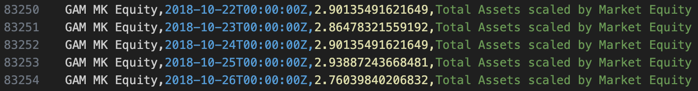
Formula Parser R - Factor Computation
Formula Engine
Balances syntax, cleans up formulas, and parses text into R expressions
Utilizes helper functions built to accurately parse constructed formulas
For each formula and ticker, builds a per-date data frame of inputs, then evaluates in a custom environment
Automatically skips any formulas that error or yield no results
Export Step
Run all parsed formulas and output combined factor results to computed_factors.csv
Source: formula_parser.r
Source: computed_factors.csv
Project Lab

Slide 9
Formula Parser R - Factor Computation
Feature | Functionality | Usefulness | Adaptability
Time-Aware Func- tions (LAG, LEAD, STD) | Recognizes flexible time units like “3M”, “1Y” and converts to trading days | Handles financial data frequency naturally | Adapts to various periodicity in factor design
Nested functions | Supports formulas with compound functions STD ( EXP ( LOG ())) including custom functions | Enables mathematically complex and compact expressions | No need to manually split expressions
Formula Chaining | Allows one formula to reference results from previous ones | Enables complex multi-step modeling | Easily supports derived formulas without recomputation
Ticker-wise evaluation | Processes each equity’s data independently | Maintains clean separation across securities and records error | Scales well to different groups of tickers of interest
Project Lab

Slide 10
Back-Testing Pipeline
Point-in-Time Data Collector in Excel
Project Lab

Slide 11
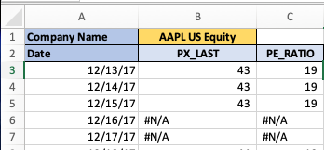
Point-in-Time Data Collector – Description
We collected Point-in-Time data using Excel
We used the BQL.QUERY that can be enabled in Excel
Syntax:
=@BQL.QUERY("get(" & B$2 & ") for('" & $B$1 & "') with(DATES=" & TEXT($A3,"yyyy-mm-dd") & ")")
Users need only to change the ticker name for the company (cell B1) to the company they are interested in
Project Lab

Slide 12
Point-in-Time Data Collector – Submitted Files
We collected 2-years worth of point-in-time data for 3 companies: Apple US Equity (US Company), GAM MK Equity (Malaysian company), CIMB MK Equity (Malaysian company)
The data collector is split between accounting and market variables to reduce the amount of data saved in one file
For each company and variable type, there are two excel files:
The file containing the formula can be run on a computer connected to an active Bloomberg Terminal to observe how the BQL.QUERY formula functions in practice and to retrieve new data
The file that doesn’t contain the formulas contains only the data extracted in the past
Project Lab

Slide 13
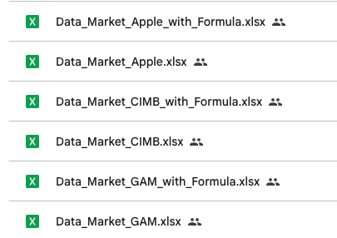
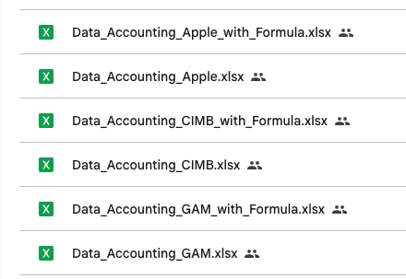
Point-in-Time Data Collector – Submitted Files
Project Lab

Slide 14
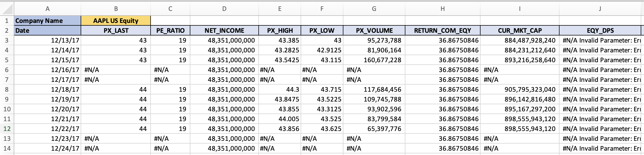
Point-in-Time Data Collector – Submitted Files
#N/A:
Data is not available during those dates (e.g., not a business day)
#N/A Invalid Parameter: Error encountered while validating field_name
The company does not have any data on that specific variable
Project Lab

Slide 15
Sensitivity Analysis
Project Lab

Slide 16
Sensitivity Analysis
Data Inputs
Computed Factors: loads a pre-computed CSV of factor values (one row per ticker‐date‐factor).
Market Prices: reads raw Excel price files for each ticker, cleans them, and computes forward returns.
Parameter Controls
Date Range: restrict the analysis window
Ticker: pick which instrument to study
Factor: select which pre-computed metric (e.g. leverage, valuation)
Horizon: choose the look-ahead period (1 day, week, month, quarter, year)
Forward Return Calculation
Forward return measures how much the price increases or decreases after a chosen number of trading days. It reflects the future price movement from a given starting point.
Visualization
The app creates a scatter plot showing the relationship between the selected factor and the forward return. Each point represents a historical observation for the selected ticker and date range.
Project Lab

Slide 17
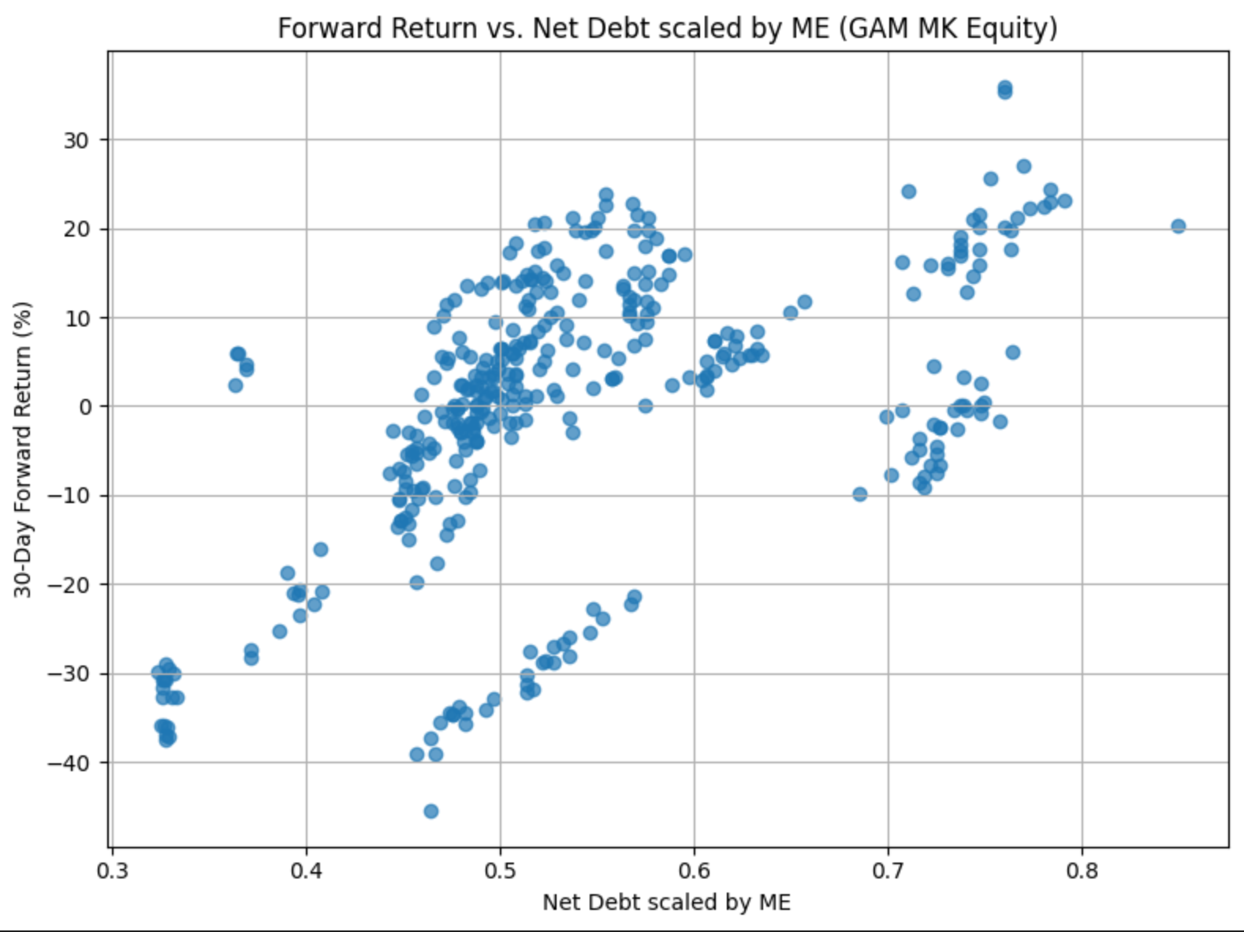
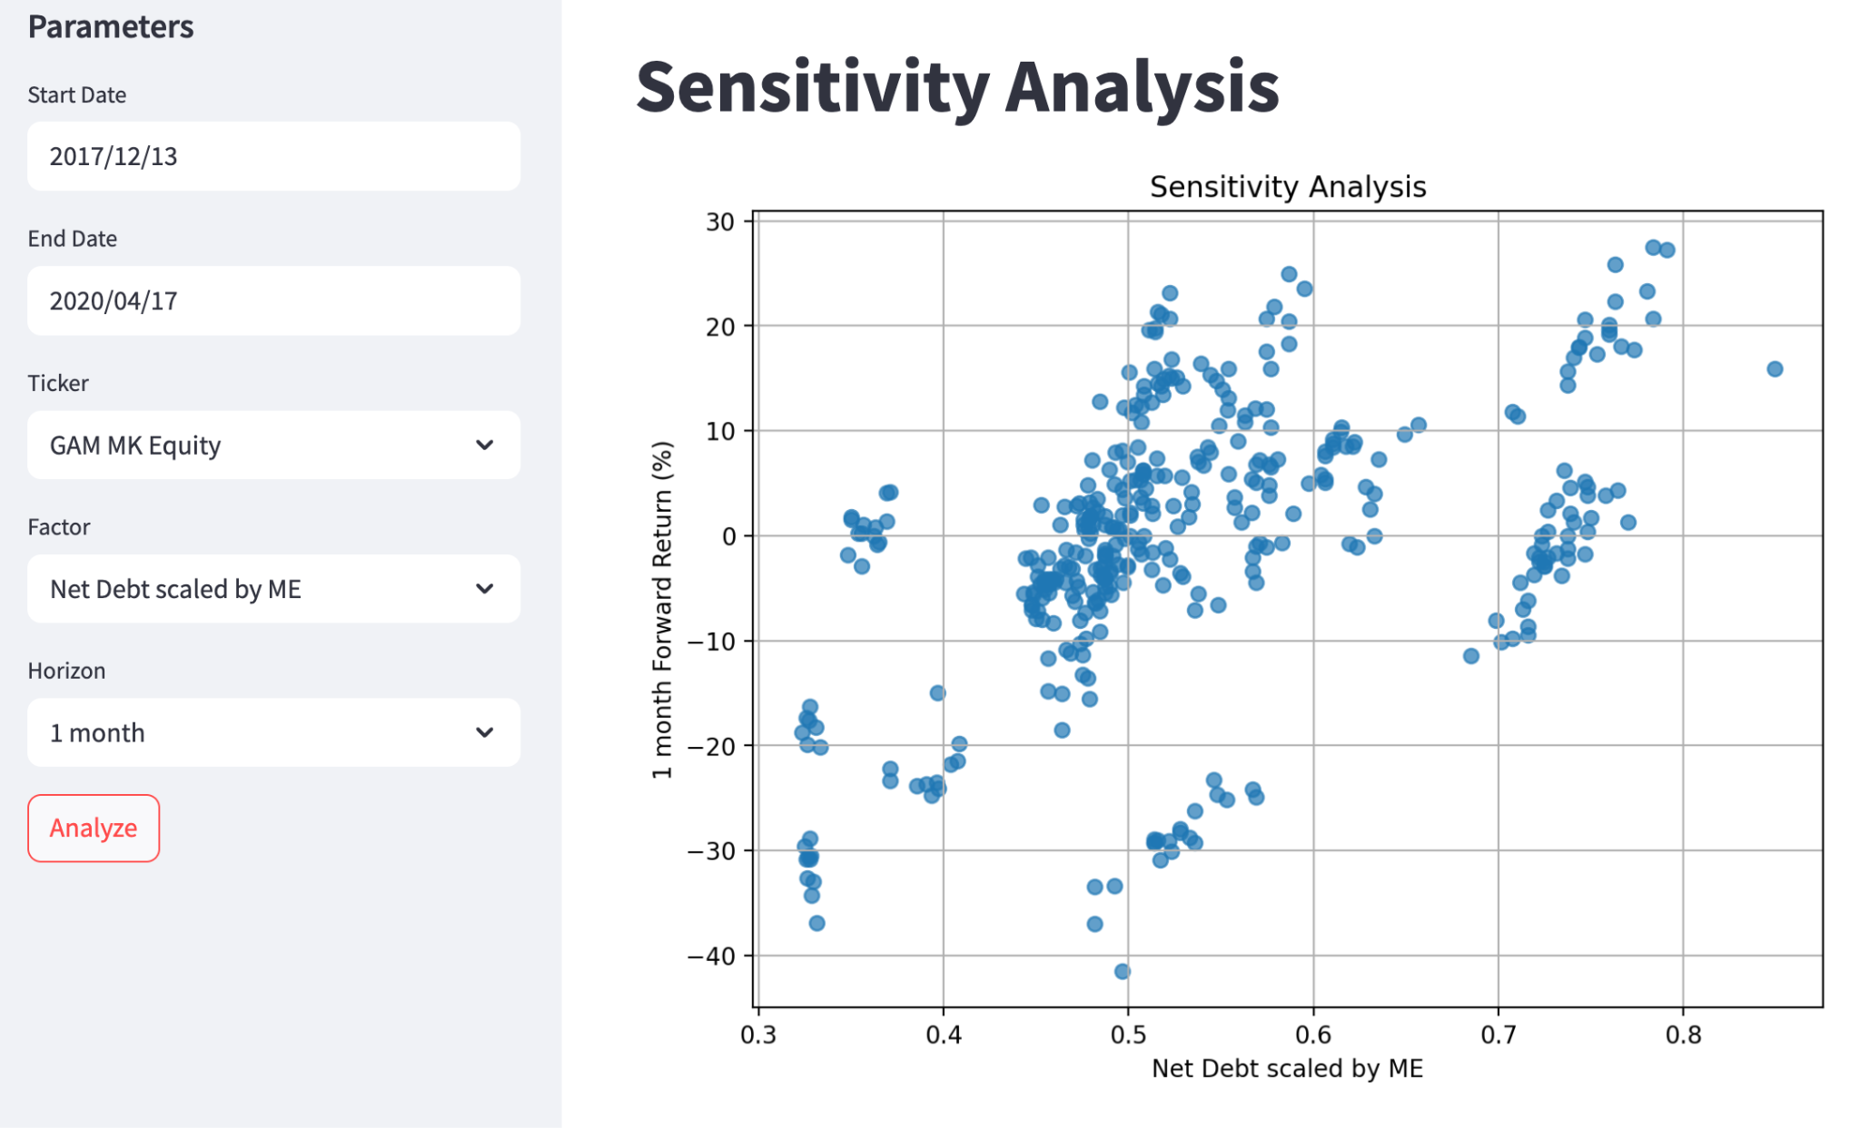
Sensitivity Analysis
Jupyter Notebook
Python Application UI
Source: sensitivity_analysis_notebook.ipynb
Source: sensitivity_analysis_UI.py
Project Lab

Slide 18
Sensitivity Analysis
Note:
Sensitivity analysis is available in both the sensitivity_analysis_notebook.ipynb, for a python notebook version, and sensitivity_analysis_UI.py, for a clean browser-UI program.
To run the sensitivity_analysis_UI.py version
Make sure streamlit is installed (“pip install streamlit”)
Run the program via terminal using “streamlit run sensitivity_analysis_UI.py”
The UI will then open in your browser
Ensure the following data files are in the directory of the sensitivity analysis program:
computed_factors.csv - For all the computed factors calculated from formula_parser.r
Data_Market_{ticker}.xlsx - Which contains Bloomberg PX_LAST data for the specified ticker
Project Lab

Slide 19
Challenges
Project Lab

Slide 20
Challenges – Data Collection
There are two alternative methods for data collection that may prove to be more effective
EE (Earnings Estimates) and Earnings Summary (ERN) functions in BBG
We needed to learn this with a BBG representative
The Live Help feature is disabled in the Finmath student BBG subscription
We can only communicate with BBG with a one-business-day delay
Bloomberg BLP API in Python
Succeeded in implementing blp/refdata using Python script, but blp/bql is disabled in the Finmath student BBG subscription on campus
We could only collect historical instead of point-in-time data as needed
Conclusion: We used the BQL.QUERY directly in Excel
Project Lab

Slide 21
Challenges – Data
There is often missing data from specific fields for particular tickers
Accounting variables and market variables are recorded at different cadences (daily vs quarterly for example)
Further consideration is needed for how to deal with accounting variables in the sensitivity analysis, perhaps using only quarterly data for accounting factors
Simplification assumptions were made for market factors that did not have direct Bloomberg fields. Replication of those factors were done using basic variables.
More complex market factors can be added to list of constructed variables with further attention to different time lags
Project Lab

Slide 22
Thank you
Project Lab

